Slide 1
Introduction to mixed eﬀects modeling using R
Naomi Havron
(Slides based on Alex Fine’s Introduction to LMEMs in R)

Slide 2
Review – Linear regressions
Regression answers the following question:
How do I identify the parameters of a curve that relates X to Y in a way that minimizes, on average, how wrong I am about the data?
Other words – we want to be able to say, if you give us the value of a mother’s IQ score, what would be her child’s IQ

Slide 3
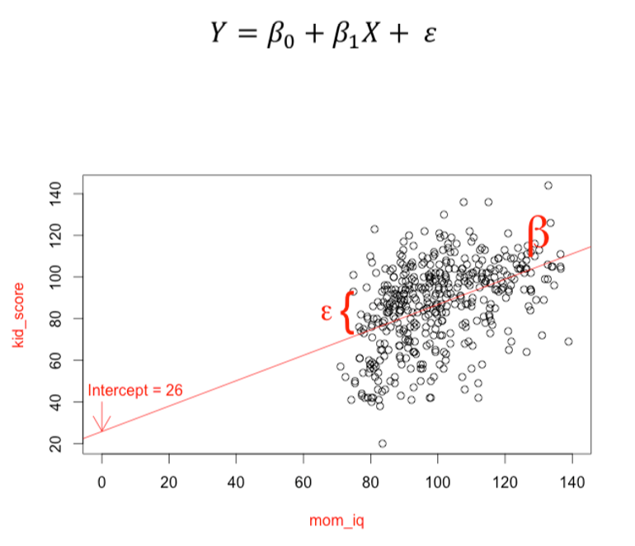
Review – Linear regressions

Slide 4
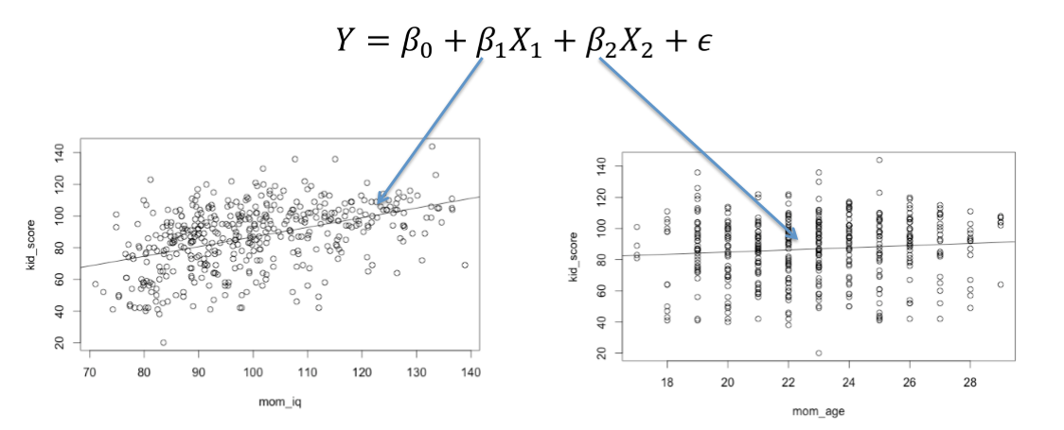
Allow us to compare the strength of different variables

Slide 5
But there will be times when linear regressions will be inadequate
When observations are grouped in some interesting way (e.g. clients of the same social worker).
When we are interested, at the same time, in between-subject and within-subject parameters (e.g., frequency and age).

Slide 6
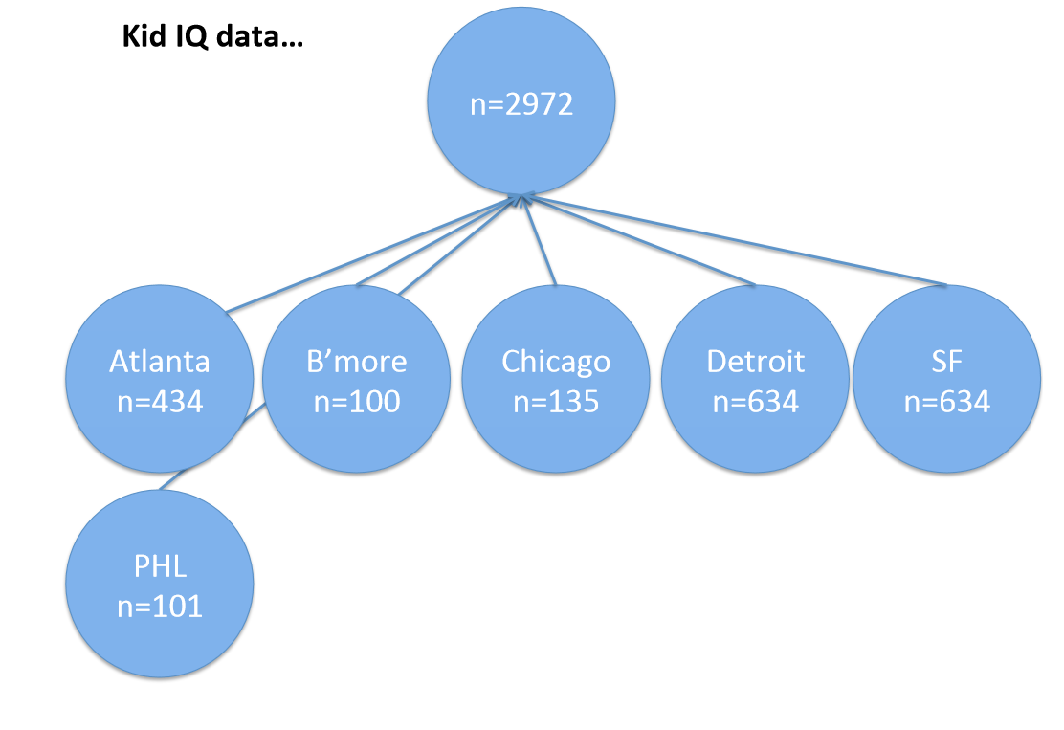

Slide 7
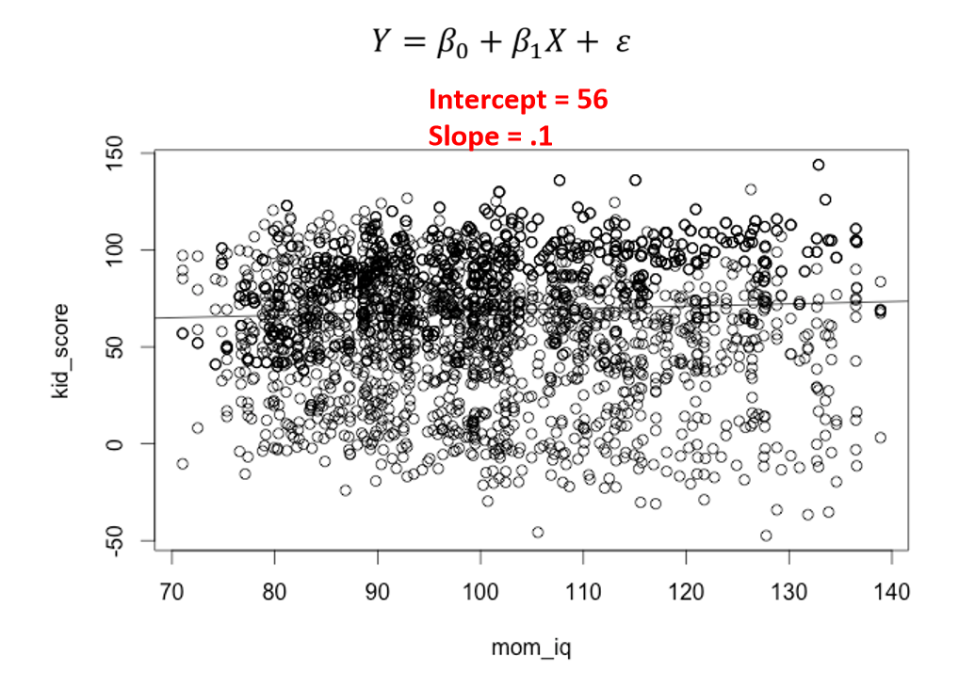

Slide 8
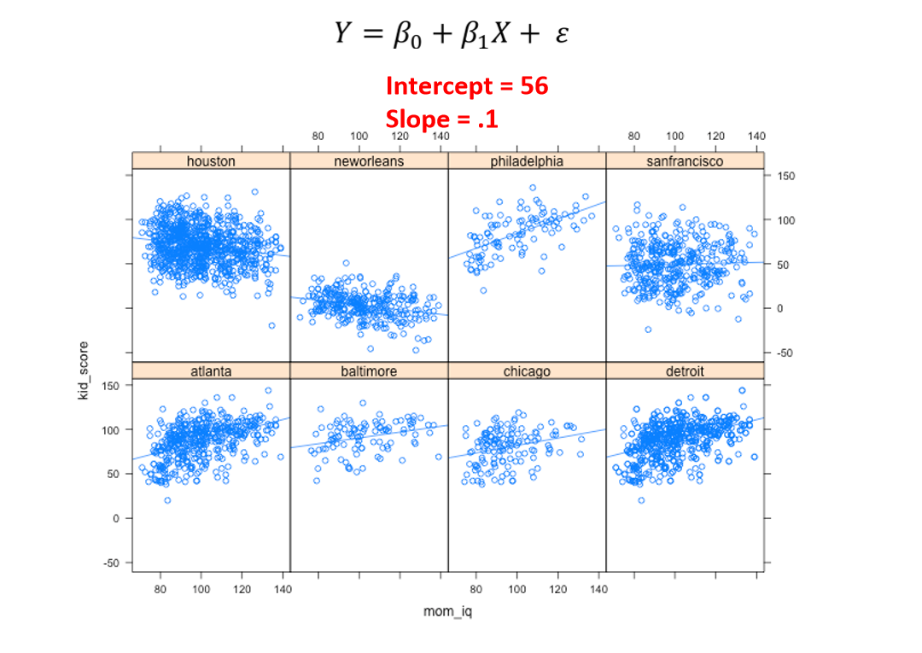

Slide 9
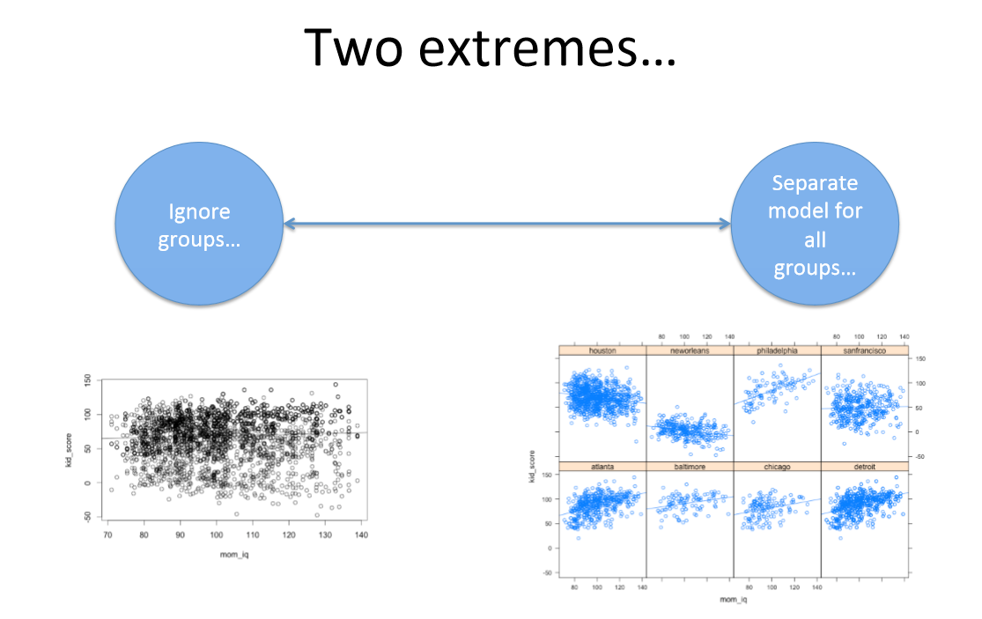

Slide 10
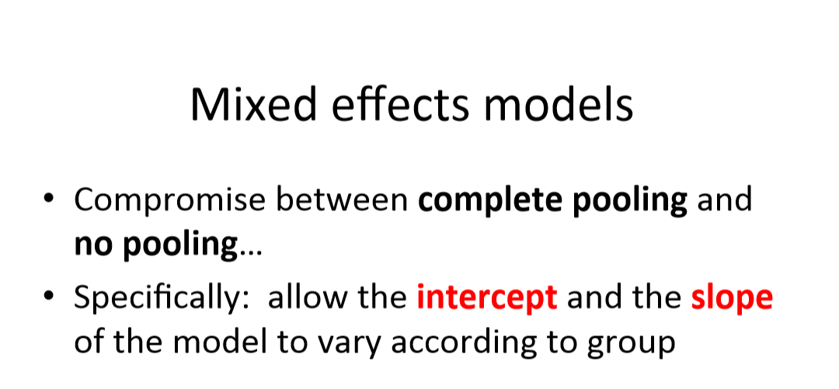

Slide 11
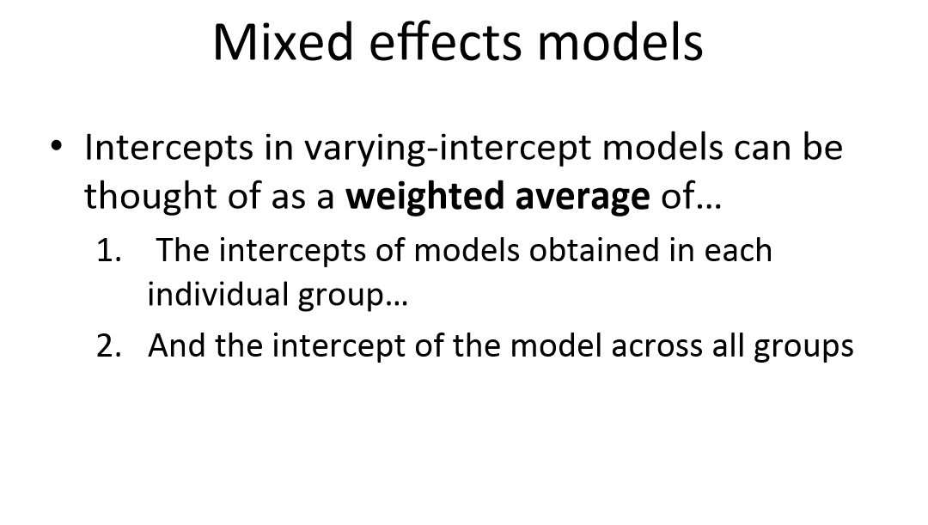

Slide 13
#Go to code

Slide 14
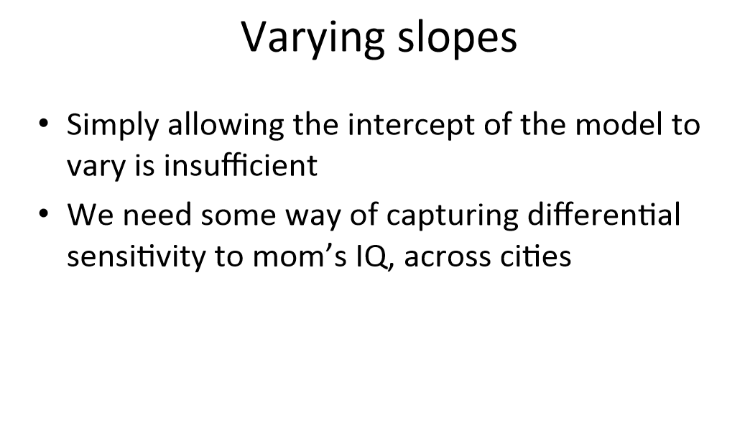

Slide 15
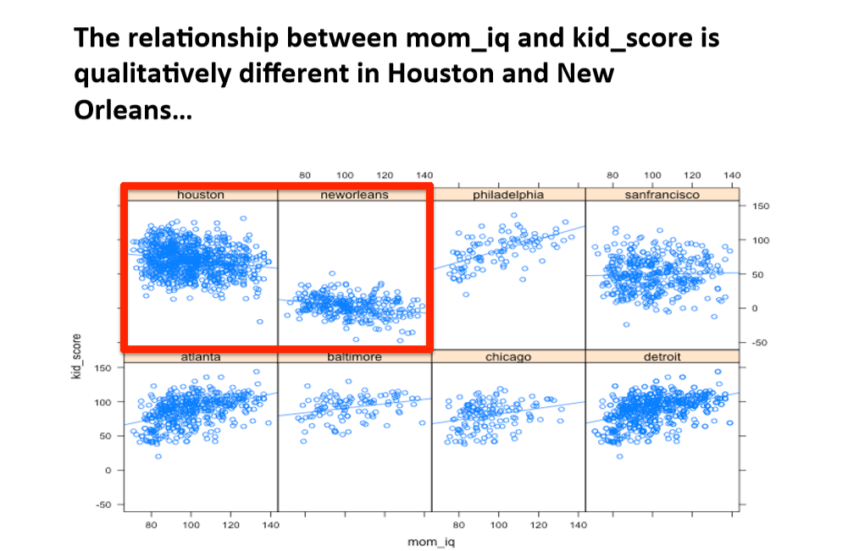

Slide 16
Are our effects robust to differences between cities? Will they generalize?

Slide 17
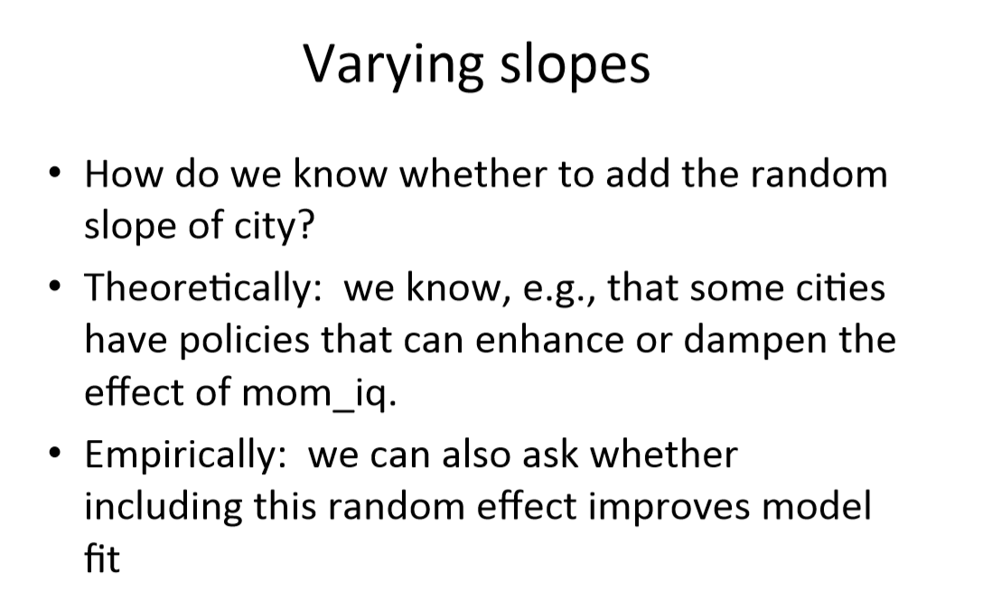

Slide 18
#Go to code

Slide 19
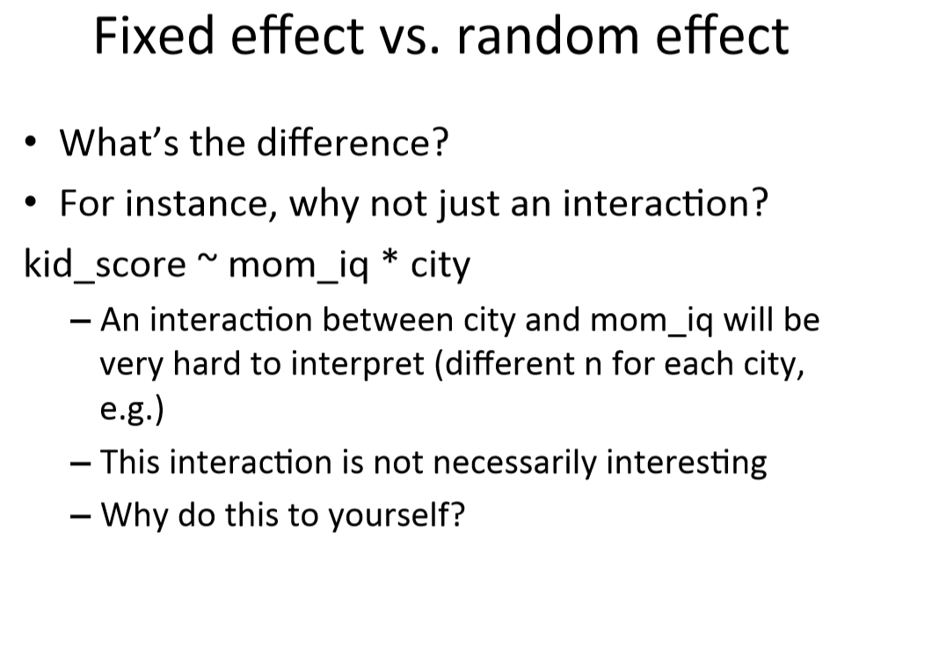

Slide 20
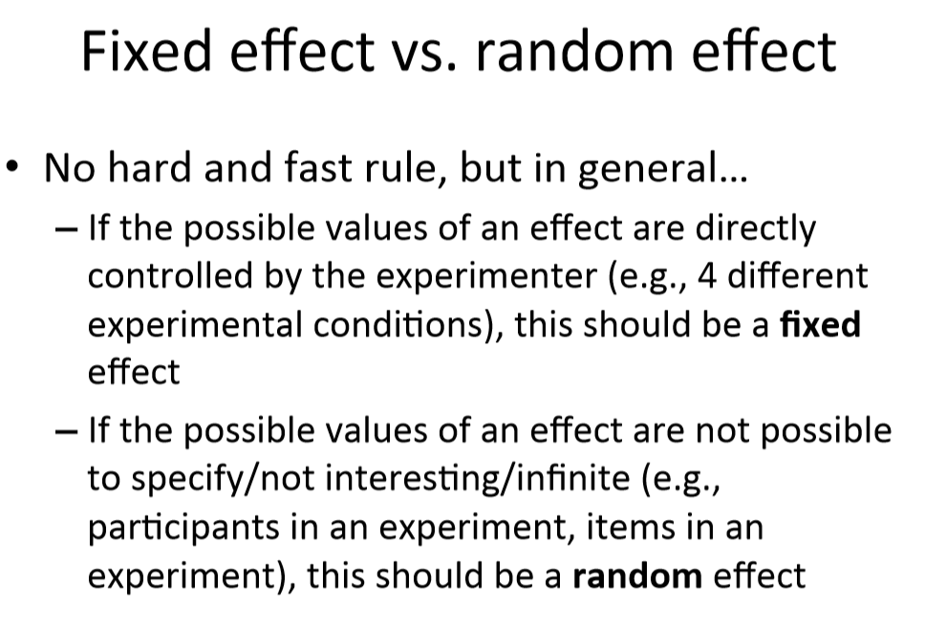

Slide 21
How do I determine my random-effects structure?
Decisions can be based on:
Data – some people do this and there is arguments in the literature, I was taught not to do this
Design – every factor that is of theoretical significance and can logically be a slope goes in!

Slide 22
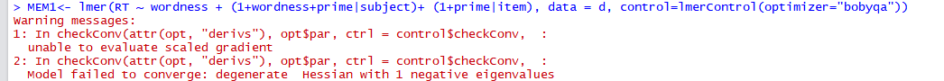
How do I determine my random-effects structure?
Design – every factor that is on theoretical significance
"but now my model doesn't converge!“
Notes:
Fitting LMEMs typically involves maximum likelihood estimation, where an iterative procedure is used to come up with the “best” estimates for the parameters given the data. As the name suggests, it attempts to maximize the likelihood of the data given the structure of the model. Sometimes, however, the estimation procedure will fail to “converge” (i.e., to find a solution) within a reasonable number of iterations. The likelihood of this convergence failure tends to increase with the complexity of the model, especially the random effects structure.

Slide 23
How do I determine my random-effects structure?
Design – every factor that is on theoretical significance
"but now my model doesn't converge!“
Start by removing factors that are less important theoretically
Remove items associated with lower variance
you can remove an intercept without removing the slopes: (0+factor|item)
You can remove main effects and leave interaction: (1+factor_1:factor_2|item)

Slide 24
#Go to code

Slide 25
Or – Parsimonious models
“Runs a principal component analysis on the random effects structure then refits the model keeping only the main components … This method avoids fitting an overly complex random effect structure when the data does not support it.” (Cremers, A., PC; real reference: Bates et al., 2015)

Slide 26
#Go to code

Slide 27
Coding categorical data
We will focus on the main two coding schemes:
Dummy coding
Sum coding

Slide 28
Coding schemes
Dummy coding: One group is the reference group, the other is compared to it.
Sum coding: We compare to the grand mean.

Slide 29
#Go to code

Slide 30
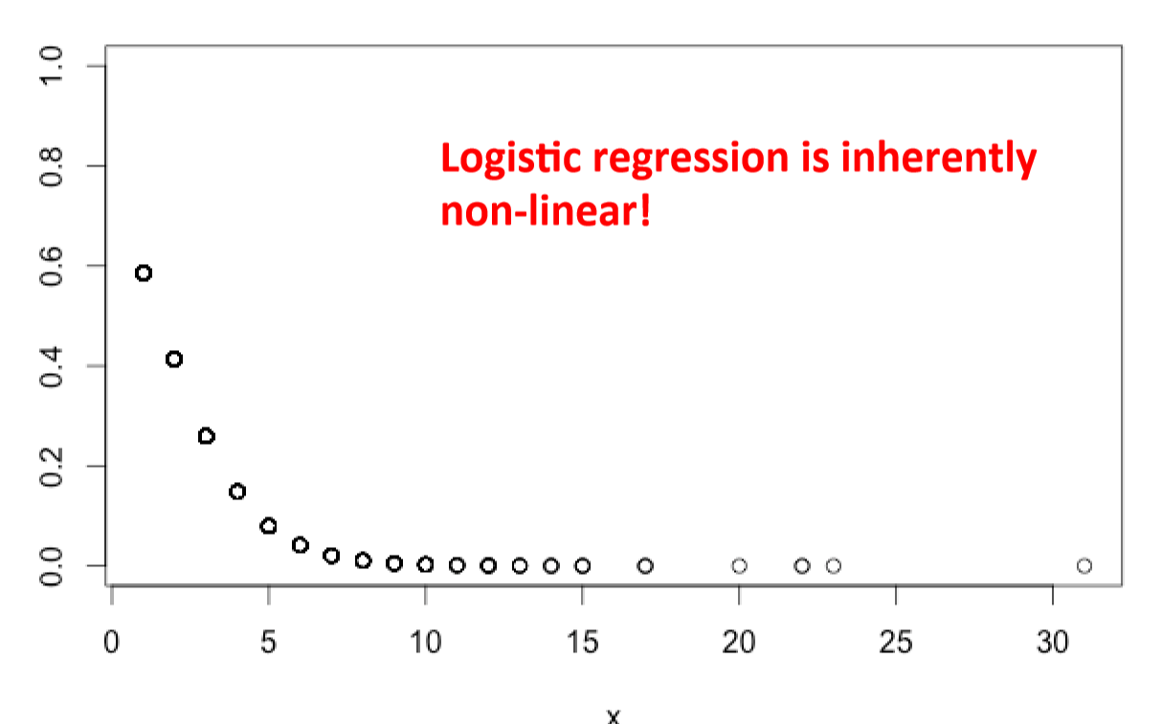
Logistic regressions
How do changes in the independent variables affect the probability of the outcome measure (in logit space).
To go back to probabilities you can use the function inv.logit()but beware that:

Slide 31
#Go to code

Slide 32
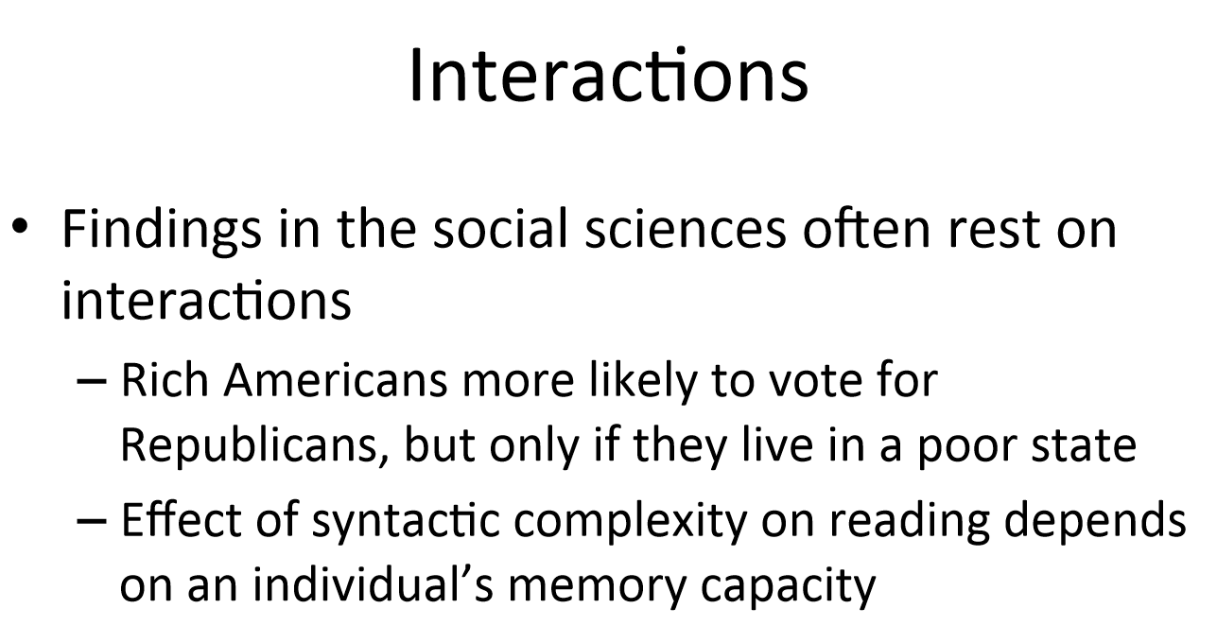

Slide 33
Specifying an interaction:
Factor_1*Factor_2
Interaction + main effects
Factor_1:Factor_2
Interaction only

Slide 34
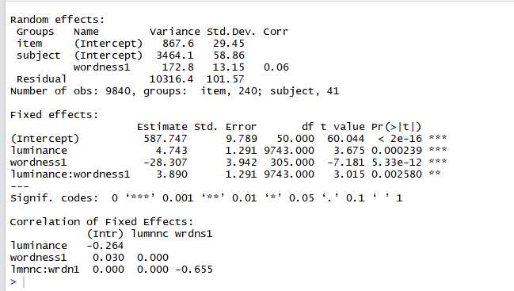
Output for the interaction

Slide 35
Output for the interaction

Slide 36
Output for the interaction

Slide 37
Which way does my interaction go?
Look for the sign (+/-) – not enough
Simple slopes test
How to do model comparisons with interaction?
Graph it…

Slide 38
Interactions – Nura Sidarus
General linear hypothesis testing
i.e. doing t-tests on point estimates of contrasts
Generate model predictions
NB. Helps to use:
orthogonal (i.e. sum) contrast coding (categorical)
centred, or standardised predictors (continuous)

Slide 39
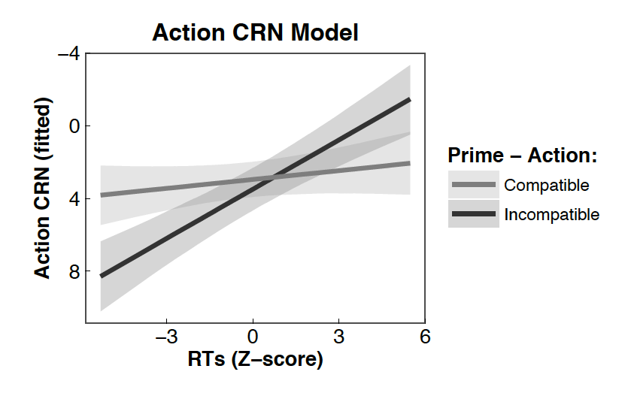
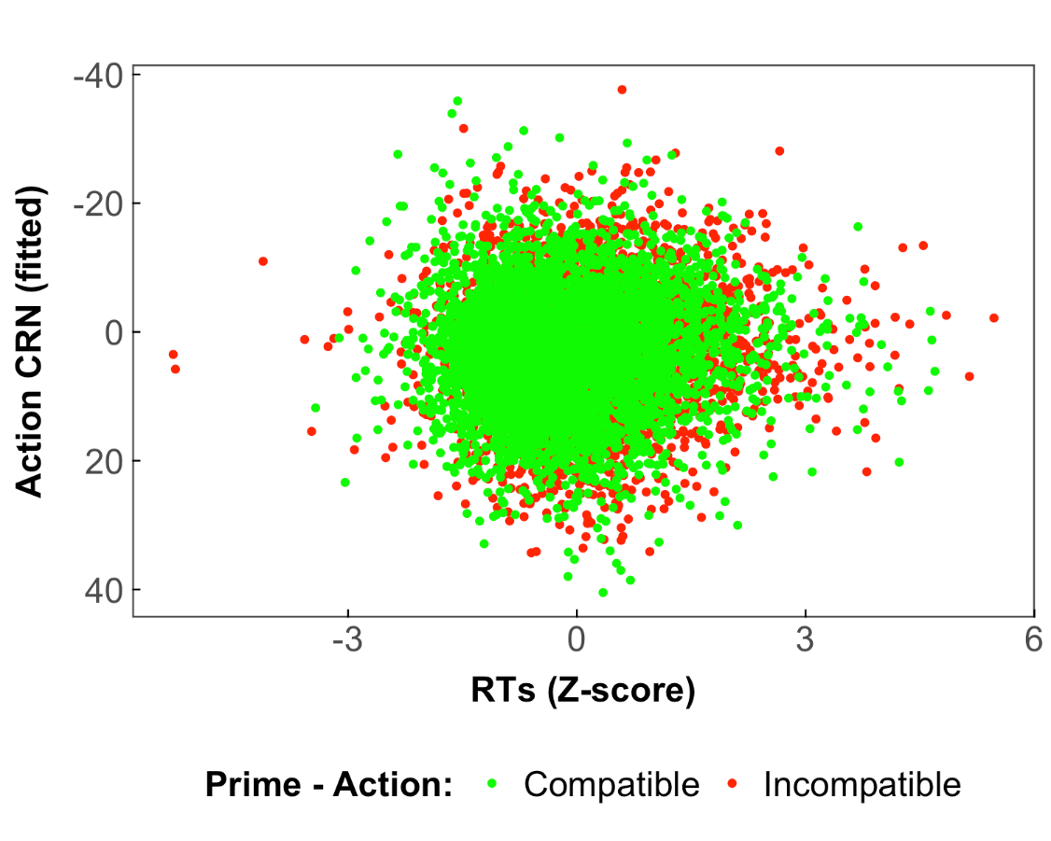
Effect of priming on Action CRN is limited to average (SD = 0) and fast (SD = 1) RTs
Sidarus, Vuorre & Haggard 2017 NeuroImage

Slide 40
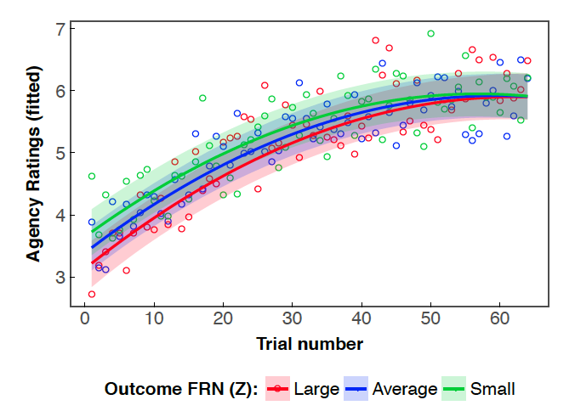
Outcome FRN is only related to agency ratings at the start of the block
Sidarus, Vuorre & Haggard 2017 NeuroImage

Slide 41
#Go to code

